Slide 1
Team
Supervision
Assistant:
Eng. Sama Ayman
محمد شوقي محمد رزق
ياسر نبيل محمد محمد
محمود سيد علي أحمد
صلاح الدين علاء محمد
عبد الرحمن محمود محمد
مصطفي طارق مصطفي
Supervised by:
Dr. Ashraf Fahmy

Slide 2

Breast Cancer Detection
Here is where our study begins..

Slide 3
Introduction
Breast cancer is a significant global health concern affecting millions of women worldwide. Early detection plays a crucial role in improving the chances of successful treatment and survival.
The goal of our project is to create an accurate and effective breast cancer detection system by utilizing deep learning models.
Additionally, we have successfully developed a mobile application that is based on our deep learning algorithms.
Enabling real-time and instantaneous predictions.

Slide 4
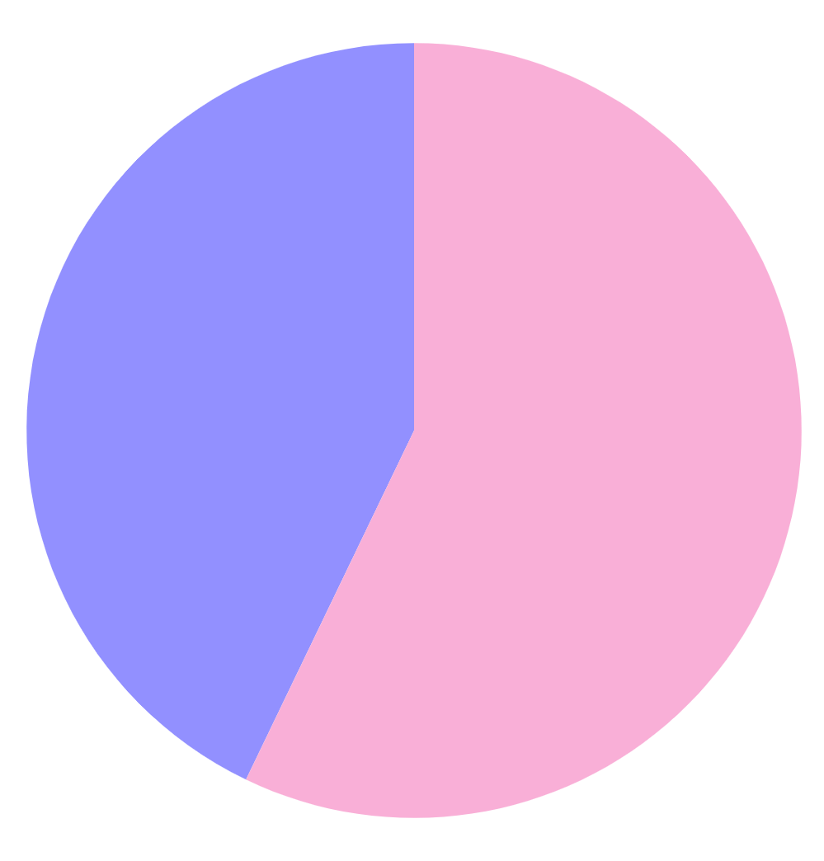
Findings
Women
Men
1%
99%
2,300,00
The number of breast cancer cases in women according to the World Health Organization (WHO), in 2020, there were approximately 2.3 million new cases of breast cancer in women globally.

Slide 5
Problem Statement
Current breast cancer detection methods often rely on a manual examination of mammograms or histology slides, which can be time-consuming and subject to human error.
The problems we pursue to solve in our project are:-
The need to find and apply a proactive method for breast cancer detection.
Creating a robust system that could help doctors in making more accurate and timely diagnoses.
Automating the detection process. As we intend to reduce the overload medical experts and enhance the efficiency of diagnosis.

Slide 6
What we will do?
Our purpose is to develop two deep learning models using Convolutional Neural Network (CNN) with a high accuracy.
1- The first model is for analyzing X-ray images.
2- And the second model is for analyzing histology images.
These two models enabling a more thorough analysis that
leads to a better results.
3- The final step, which is incorporating our models into a mobile
application.

Slide 7
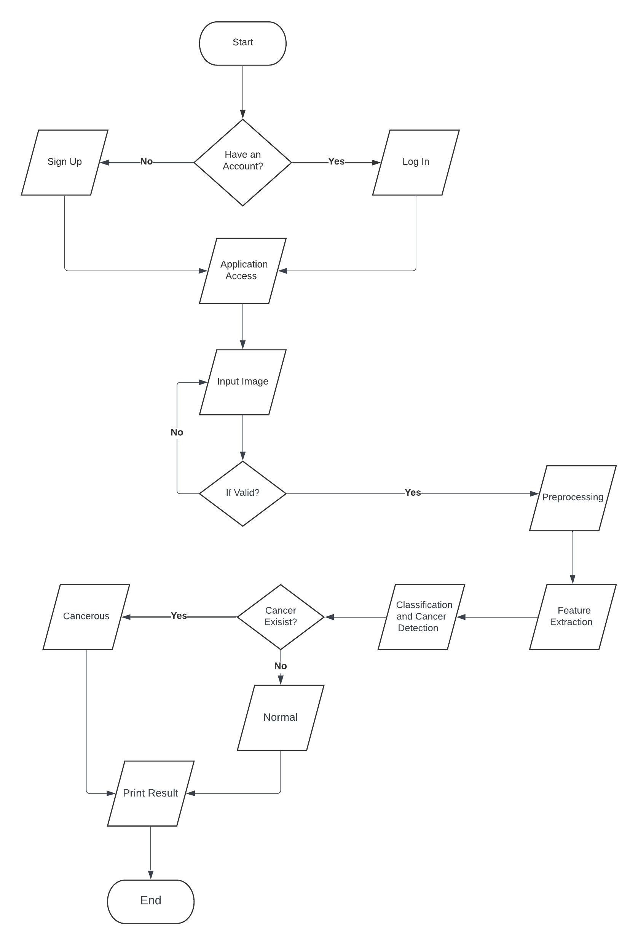
Diagrams illustrating the overall workflow of the system

Slide 8
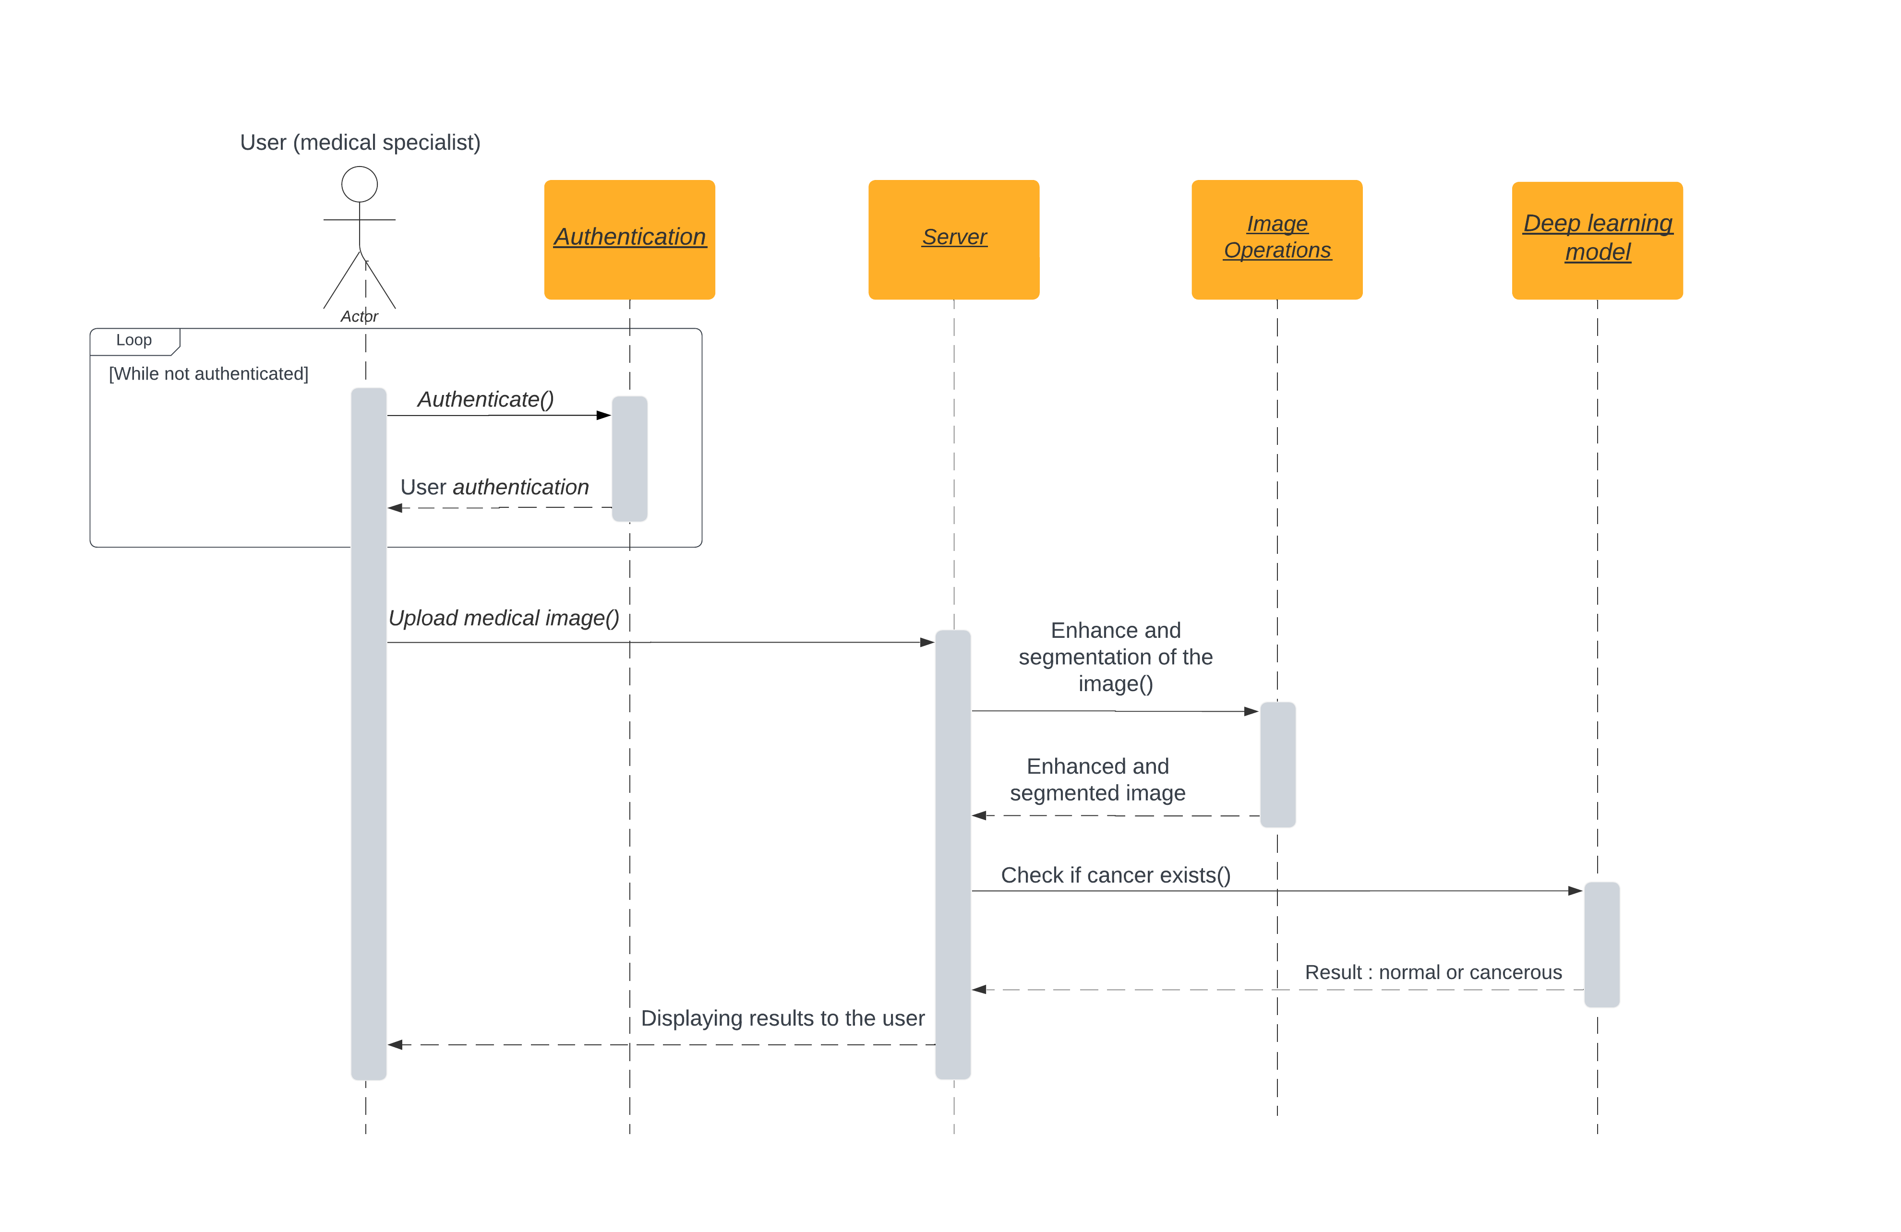
Diagrams illustrating the overall workflow of the system

Slide 9
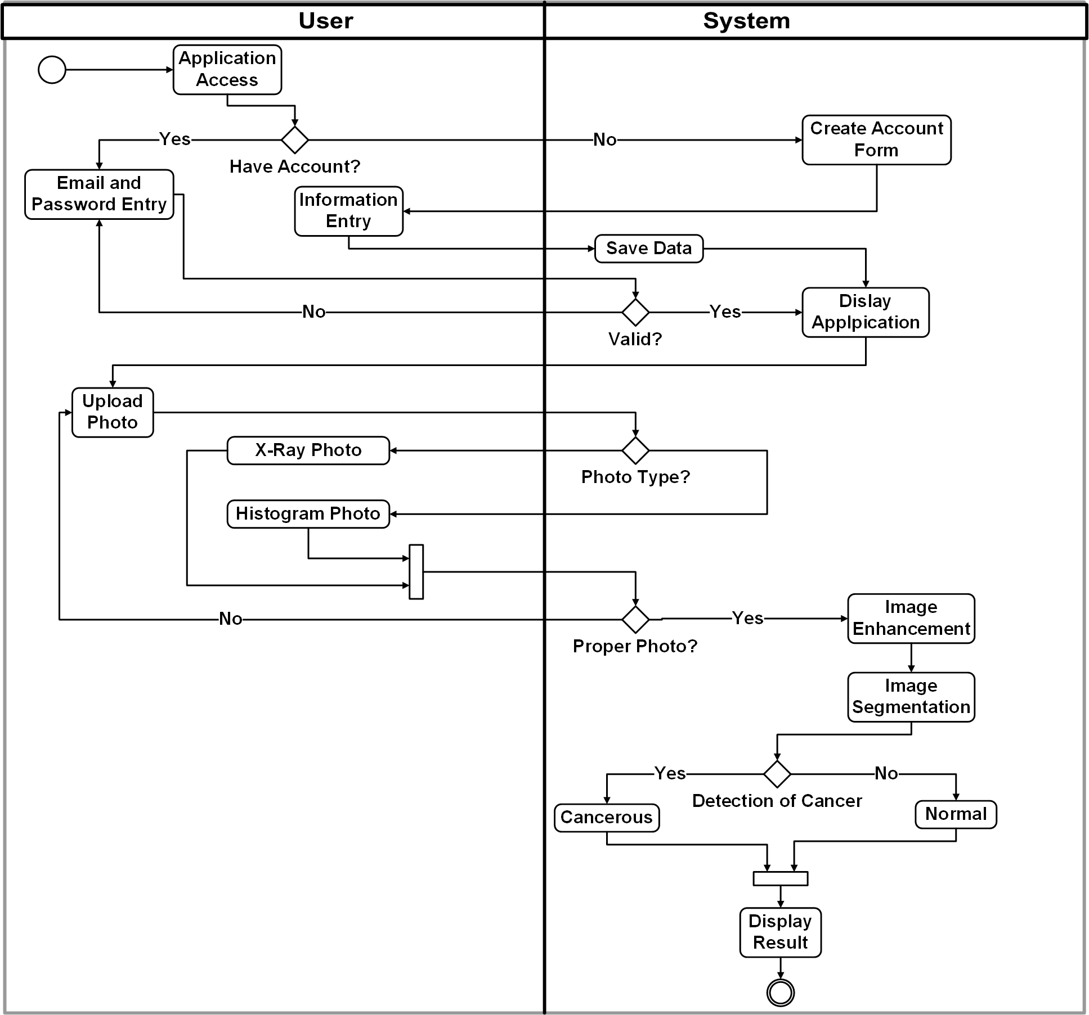
Diagrams illustrating the overall workflow of the system

Slide 10
Dataset
For x-ray model
Total number of the images is 54706.
Dataset split into two classes (Cancer and Normal),
Number of images classified as Normal are 53548.
Number of images classified as Cancer are 1158.
Number of patient 11913

Slide 11
Dataset
Before training we split the dataset into Train Set and Test Set with
80% to the training and 20% to the testing
Normalization
resizing the images to (512 * 512)
Making over sampling to balance image Cancer and Normal After over sampling:
Total number of images classified as Normal are 53548.
Total number of images classified as Cancer are 53548.

Slide 12
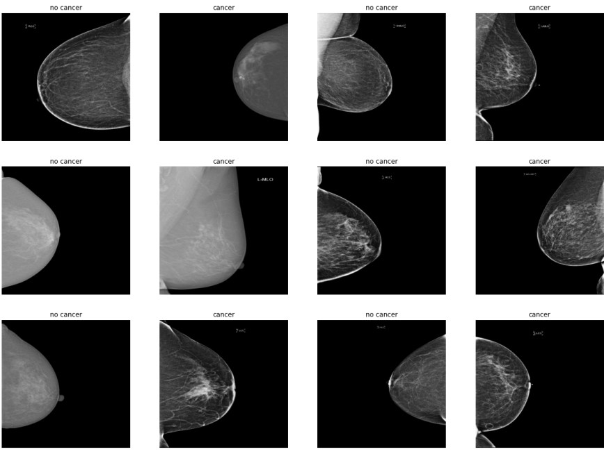
Sample:

Slide 13





Tools we used for building the Histology & X-Ray models:
Python programming language
TensorFlow framework
Keras API
Anaconda distribution
Jupyter Notebook

Slide 14
X-ray model
Deep learning simulation of the human brain
X-ray images can provide valuable information about characteristics of tumors within the body
A CNN algorithm, short for Convolutional Neural Network algorithm, is a specific type of deep learning algorithm commonly used for analyzing and processing visual data, such as images or videos. CNNs are highly effective in tasks such as image classification, object detection, and image segmentation.

Slide 15
Architecture and Components:
The model is Sequential
Input Layer: X-ray images of the breast as input with a dimension of
(512 * 512), and pass it to layers for processing.
Convolutional Layers: These layers apply convolution operations to extract features from the input images.

Slide 16
Max Pooling Layers: These layers downscale the spatial dimensions of the feature maps generated by the convolutional layers.
Flatten Layer: This layer converts the 2D feature maps into a 1D vector.
Output layer: responsible for producing the predictions for breast cancer classification.

Slide 17
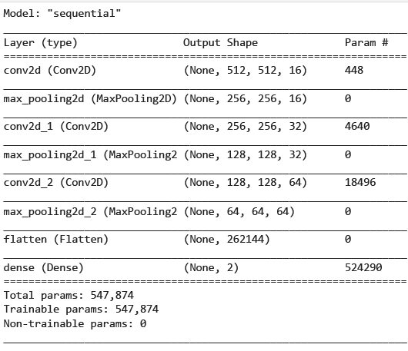

Slide 18
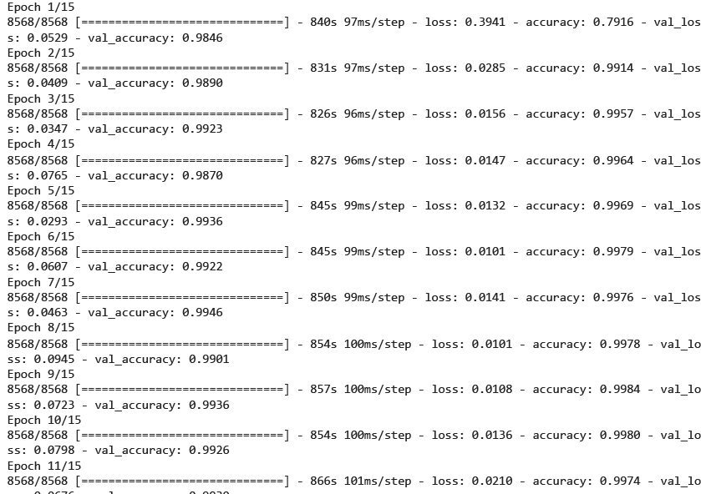
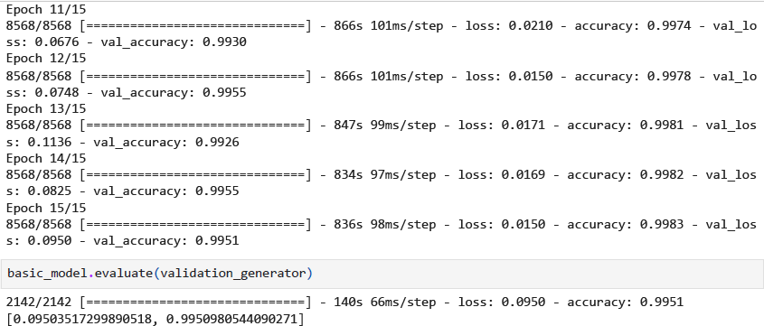

Slide 19
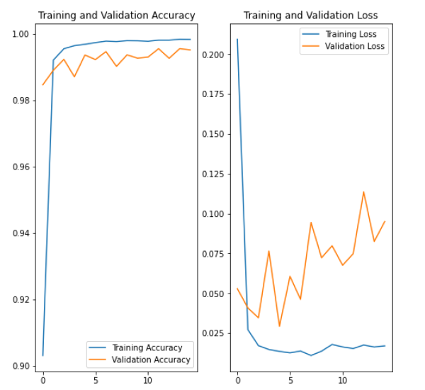

Slide 20
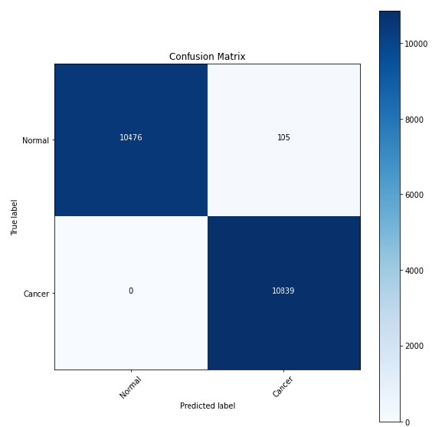
True Positive (TP): The model correctly predicted the positive class.
True Negative (TN): The model correctly predicted the negative class.
False Positive (FP): The model incorrectly predicted the positive class when the actual class was negative.
False Negative (FN): The model incorrectly predicted the negative class when the actual class was positive

Slide 21
Dataset
For Histology model
Dataset of contains a large number of histopathology images.
Total number of the images is 277524.
Dataset split into two classes (Cancer and Normal),
Number of images classified as Cancer are 78786.
Number of images classified as Normal are 198738.
Before training : we split the dataset into Train Set and Test Set with 80% to the training and 20% to the testing.
Normalization
Resizing the images to (50 * 50)

Slide 23
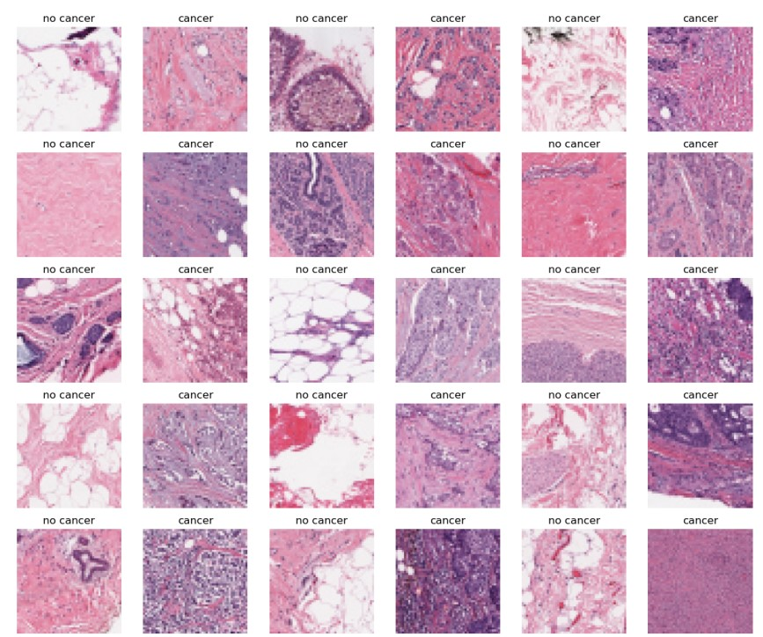
Sample:

Slide 24
Histology Model
Histopathology images:
Microscopic images mounted on glass slides.
provide detailed information about the cellular and tissue-level changes
The model is Sequential

Slide 25
Architecture and Components:
Input Layer: Receives the histopathology images of breast tissue as input, and pass it to the subsequent layers for processing.
Convolutional Layers: apply convolution operations to extract features from the input images.
Max Pooling Layers: downscale the spatial dimensions of the feature maps generated by the convolutional layers.
Flatten Layer: This layer converts the 2D feature maps into a 1D vector.
Output layer: responsible for producing the predictions for breast cancer classification.

Slide 26
This is a summary of the all layers in the model and the total number of parameters applied to be used at training phase.

Slide 27
Epoch 20/25
2961/2961 [==============================] - 592s 200ms/step - loss: 0.0216 - accuracy: 0.9923 - val_loss: 0.2011 - val_accuracy: 0.9671
Epoch 21/25
2961/2961 [==============================] - 590s 199ms/step - loss: 0.0204 - accuracy: 0.9929 - val_loss: 0.1945 - val_accuracy: 0.9659
Epoch 22/25
2961/2961 [==============================] - 585s 198ms/step - loss: 0.0185 - accuracy: 0.9936 - val_loss: 0.2151 - val_accuracy: 0.9661
Epoch 23/25
2961/2961 [==============================] - 580s 196ms/step - loss: 0.0171 - accuracy: 0.9941 - val_loss: 0.2287 - val_accuracy: 0.9673
Epoch 24/25
2961/2961 [==============================] - 581s 196ms/step - loss: 0.0168 - accuracy: 0.9940 - val_loss: 0.2036 - val_accuracy: 0.9654
Epoch 25/25
2961/2961 [==============================] - 593s 200ms/step - loss: 0.0165 - accuracy: 0.9943 - val_loss: 0.2114 - val_accuracy: 0.9638

Slide 28
(TP): The model correctly predicted the positive class.
(TN): The model correctly predicted the negative class.
(FP): The model incorrectly predicted the positive class when the actual class was negative.
False Negative (FN): The model incorrectly predicted the negative class when the actual class was positive.
True Negative
False Positive
False Negative
True Positive

Slide 29
Shows the training and validation loss values over the training epochs.

Slide 30
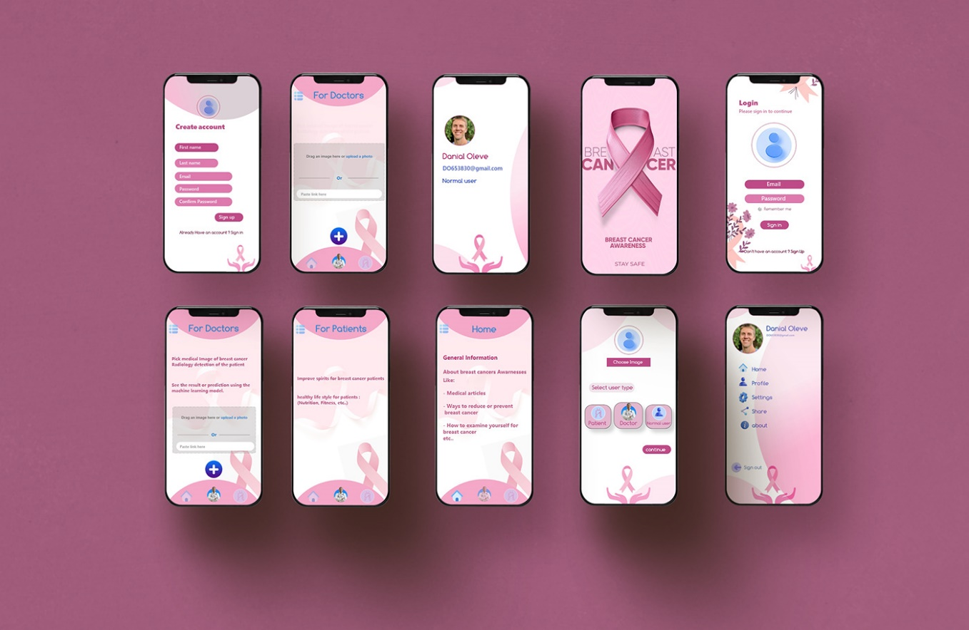
Mobile Application
The purpose of the mobile app: to provide a user-friendly interface that connects our X-ray and histology deep learning models
UI UX of the app:

Slide 31


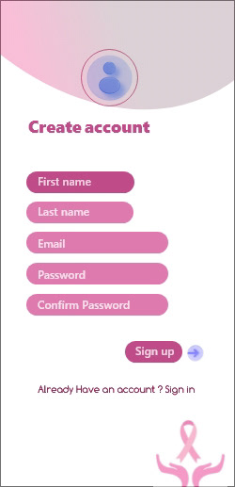
Pictures of the application
1-Splach screen 2-Login page 3-Signup page

Slide 32
Pictures of the application
1-Splach screen 2-Login page 3-Signup page

Slide 33


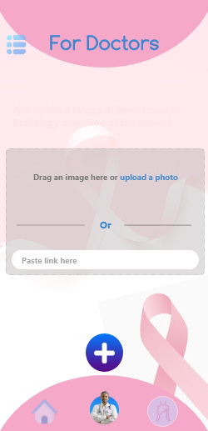
4-Home page 5-For Patient page 5.2-For Doctors (Load image )page

Slide 34
4-Home page 5-For Patient page 5.2-For Doctors (Load image )page

Slide 35



To build our application we used:
Flutter Framework.
Dart programming Language.
The Backend of the app:
We used Firebase as the backend of the app.
Authentication with email and password.
Firebase Firestore as the database (mainly for saving data of the users)
Firebase Storage as a file storage (mainly for saving user images)

Slide 36
How we connected the X-ray and histology models with the mobile app for predictions:
Save the models in h5 format (after finishing training and testing).
Converting the h5 model to tflite format.
Deploy the two models to Firebase in order to work with the mobile app.
Connecting the two models to the mobile app for model inference and making predictions.

Slide 37
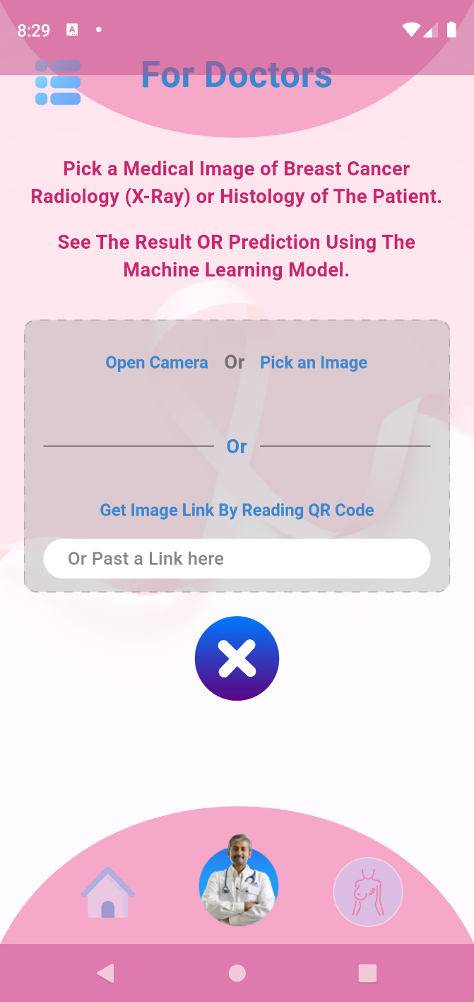
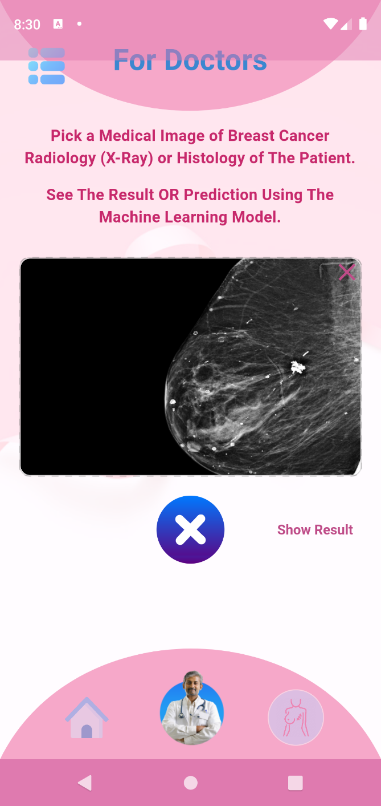
How to make predictions:
For doctor screen
The user (Doctor or radiologist) can pick an image and there are four ways to do that:
take a picture with the Camera
Pick an image from the device
Reading the QR code
paste the link

Slide 38
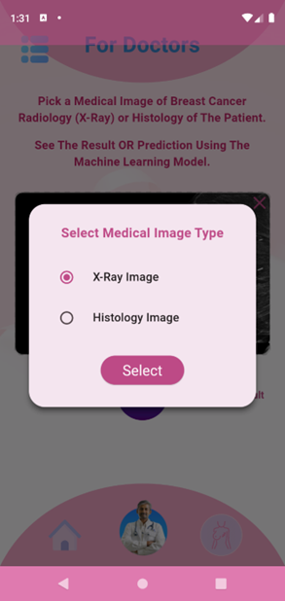
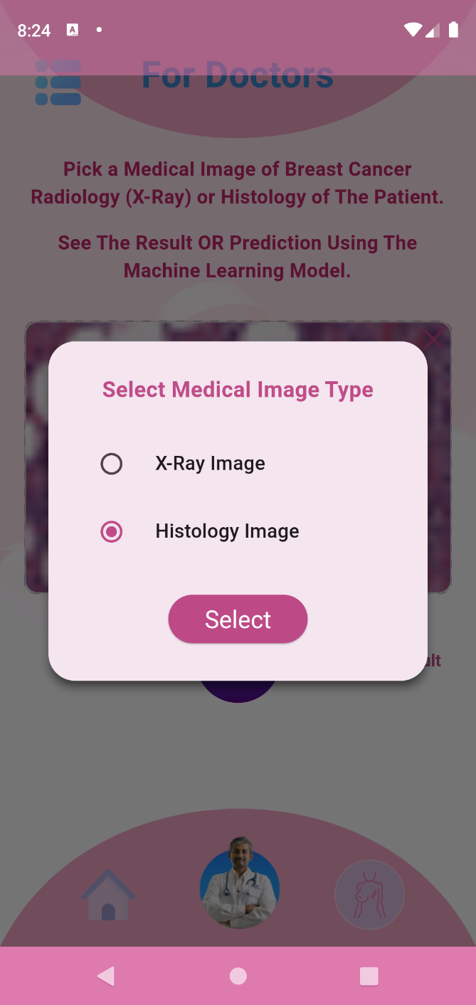
show result button ,select the medical image type

Slide 39
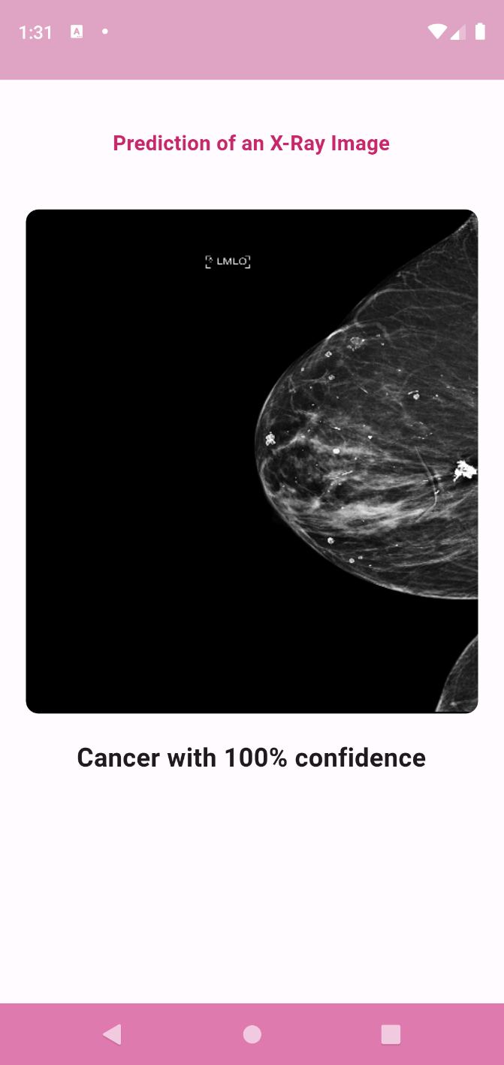
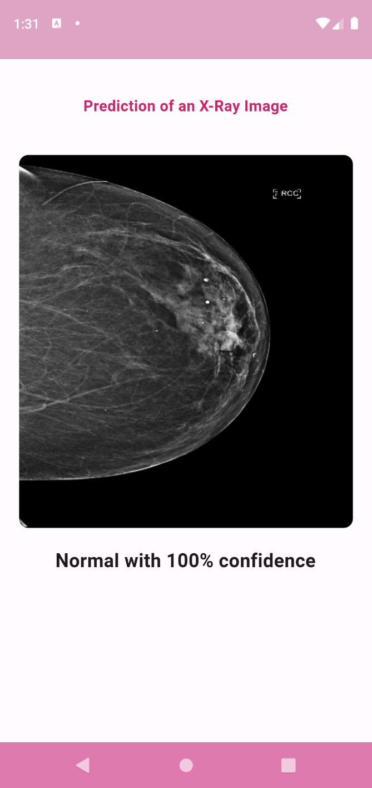
Prediction screen

Slide 40
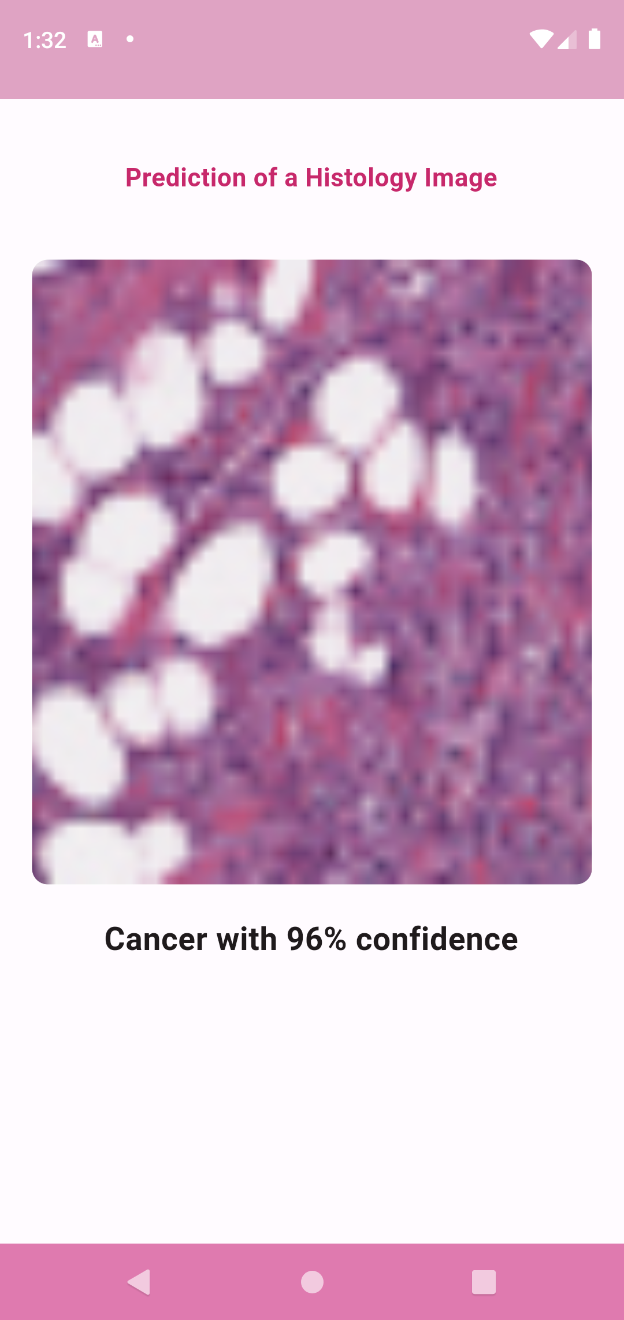
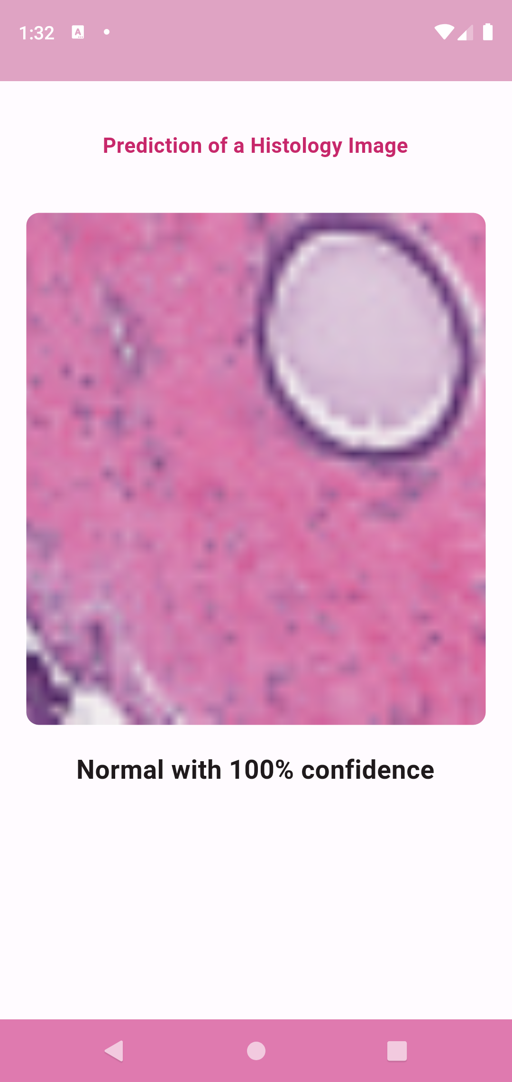
Prediction screen
In this case, the medical image is Histology and the right model is specified.

Slide 41
Live Demo of the app:
Showing a live demo and Present the overall workflow, from taking X-ray or histology images to making predictions.

Slide 42
Conclusions
and Future Work
The breast cancer detection system using deep learning models has shown significant achievements in terms of:
High accuracy.
Early detection.
High Efficiency.
Support for Radiologists.

Slide 43

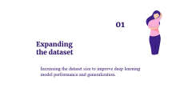
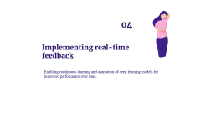


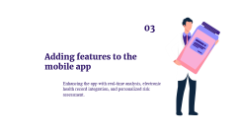
Future work

Slide 44
01
Expanding the dataset
Increasing the dataset size to improve deep learning model performance and generalization.

Slide 45
02
Exploring other imaging modalities
Investigating additional imaging techniques
Like: MRI or thermography for complementary information in breast cancer detection.

Slide 46
03
Adding features to the mobile app
Enhancing the app with real-time analysis, electronic health record integration, and personalized risk assessment.

Slide 47
04
Implementing real-time feedback
Enabling continuous learning and adaptation of deep learning models for improved performance over time.

Slide 48
05
Integrating clinical data
Incorporating patient demographics,
medical history, and genetic information
for a comprehensive and personalized approach.

Slide 49
06
Collaborating with healthcare providers
Partnering with institutions to gather diverse datasets, validate models, and ensure seamless integration into healthcare systems

Slide 50


